Slide 1
Best practices in response to the digital challenge and the needs of companies
Digitalízate Plus.

Slide 2
DIGITALÍZATE
GOOGLE SCHOLARSHIPS
ONLINE PLATFORM
SEARCH
www.digitalizateplus.fundae.es

Slide 3
Go Digital
DIGITALÍZATE
Challenge:
To leave no one behind in the Digital Transformation process.
Public-private and public-public partnership initiative to provide citizens with free, high-quality training resources to acquire digital skills.
57 Collaborating companies
+6.9M visits
+1,500 training resources
www.digitalizateplus.fundae.es
* Period analysed: December 2019 - August 2023

Slide 4
GOOGLE SCHOLARSHIPS
ONLINE PLATFORM
Collaboration agreement between Fundae and Google Spain, reached in March 2021, to provide free training for their professional certificates to find a job, grow professionally or create your own business.
Online platform whose primary purpose is to become the benchmark for training in the public sector.
10,000 scholarships
7 Google certificates
+ 97,000 applications
99% state that the training has been useful to them.
29% have found a job or are in a selection process
24/7 access
+2,500 users enrolled in the first month
The content is aimed mainly at self-employed and social economy workers but is open to all groups.
www.digitalizateplus.fundae.es
www.digitalizate-learning.fundae.es
* Period analysed: March 2021 -August 2023
* Period analysed: July 2023 - August 2023

Slide 5
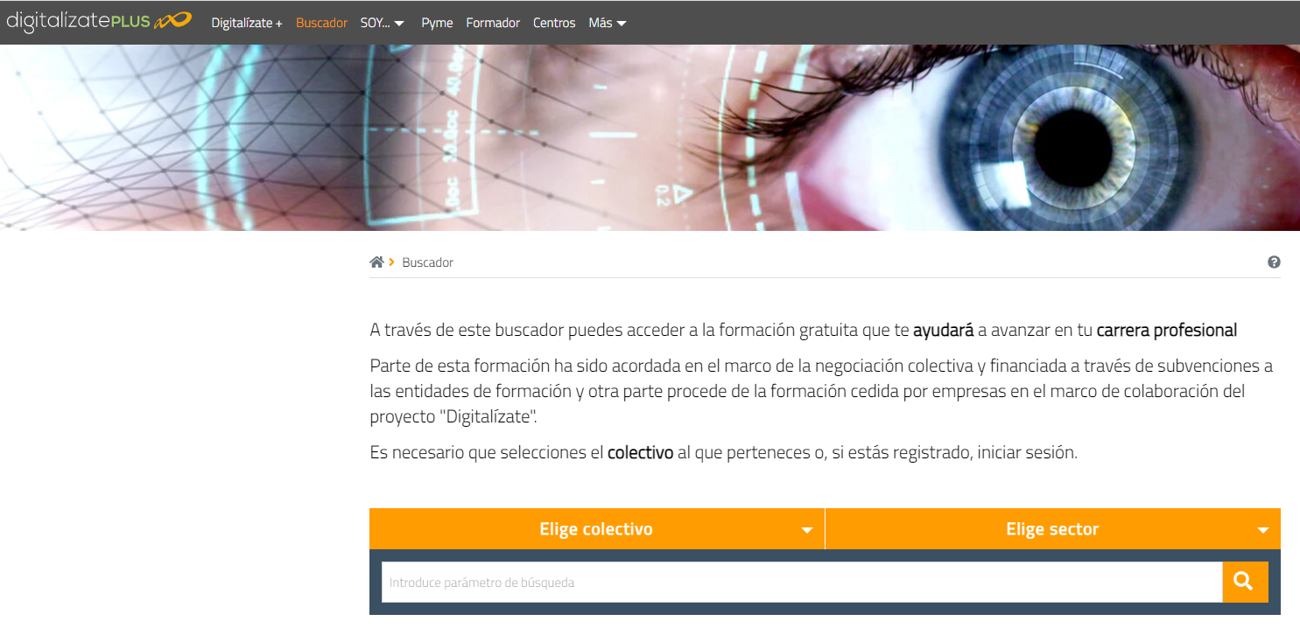
SEARCH
Following the criteria of accessibility and usability, this search engine allows us to access all the training contained in Digitalízate, Becas Google Fundae, Plataforma Online and state-subsidised training.
+3,500 Training resources
+2.5M searches
* Data: August 2023
www.digitalizateplus.fundae.es

